Slide 1
SCREEN RECORDER

Slide 2
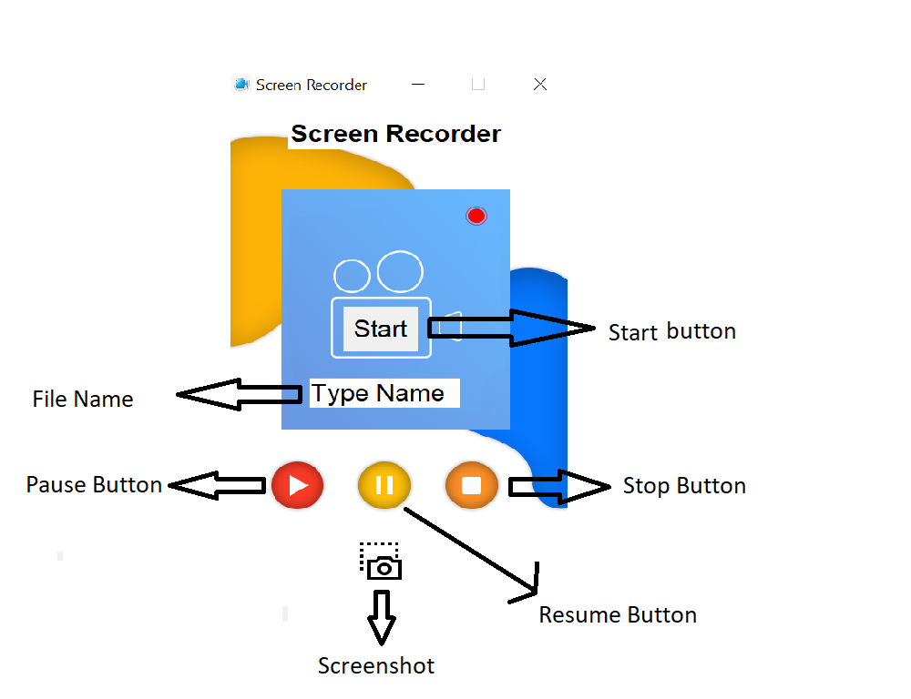

Slide 3
DESCRIPTION
Screen Recorder using python
To record our screen for presentation, we cannot rely on cameras. This is attributed to the quality and shakiness observed whilst recording. So what is the best alternative? A Screen Recorder. A screen recorder records the contents or anything visible on the screen and saves it for later use.
Now the advantages are plenty;
quality of the recording,less hassle and you can record it again at ease. Let us make Screen Recorder using python .
Prerequisites
You need to install Python in your system

Slide 4
WHY WE CREATED IT ?
For watermark issue
For providing high quality (1080p) recording
For providing additional feature of Screenshot
For providing user friendly interface

Slide 5
PROCESS
Tkinter is already available in Python. Import to see, if it is available.
import tkinter
If it does not show any error, the package is available. If not, you can install it using the command sudo apt-get install python3-tkinter, for linux users and windows users can reinstall python or follow the steps given in Tkinter installation on windows. We can use pip to install the other packages as follows:

Slide 6
Project File Structure:
Importing libraries
Creating the screen recording function
Defining the GUI
Create the components and the button
Importing libraries:
import pyscreenrec

Slide 7
Libraries Used
import pyscreenrec
import mss
Import Tkinter

Slide 8
LIMITATIONS / Features to add
Allowing Webcam
High quality sound
Provide database /cloud support

Slide 9
THANK YOU

